Slide 1
The Growth of Industry
1877-1900

Slide 2
Natural Resources Fuel Industrialization
The Growth of Industry
By 1920s, U.S. is world’s leading industrial power, due to:
Wealth of natural resources
Government support for business
Growing urban population

Slide 3
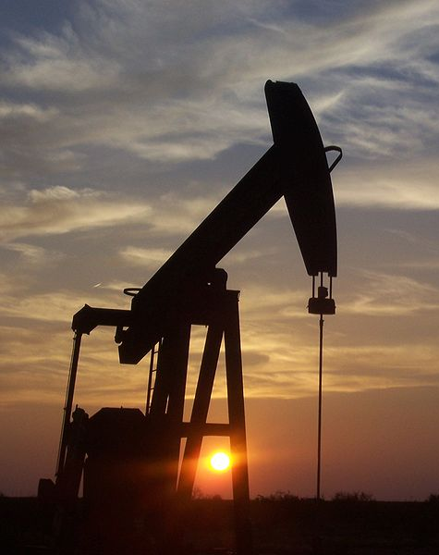
Natural Resources Fuel Industrialization
Black Gold
Pre-European arrival, Native Americans make fuel, medicine from oil
1859, Edwin L. Drake successfully uses steam engine to drill for oil
Petroleum-refining industry first makes kerosene, then gasoline

Slide 4
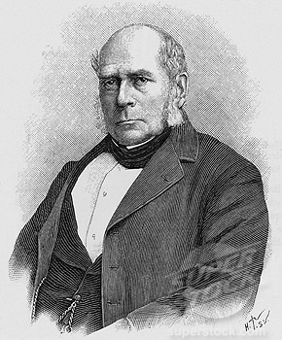
Natural Resources Fuel Industrialization
Bessemer Steel Process
Abundant deposits of coal, iron spur industry
Bessemer process puts air into iron to remove carbon to make steel

Slide 5
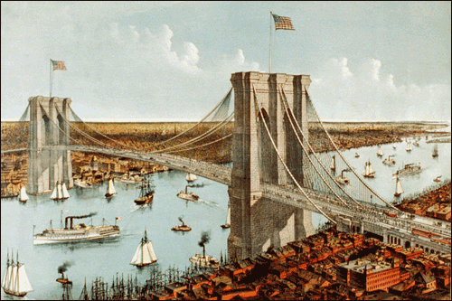
Natural Resources Fuel Industrialization
New Uses for Steel
Steel used in railroads, barbed wire, farm machines
Changes construction: Brooklyn Bridge; steel-framed skyscrapers

Slide 6
Inventions Promote Change
The Power of Electricity
1876, Thomas Alva Edison establishes first research laboratory
1880, patents incandescent light bulb
Creates system for electrical production, distribution
Electricity changes business; by 1890, runs numerous machines
Becomes available in homes; encourages invention of appliances
Allows manufacturers to locate plants anyplace; industry grows

Slide 7
Opportunities and Opportunists
Pullman
1880, George M. Pullman builds railcar factory on Illinois prairie
Pullman provides for workers: housing, doctors, shops, sports field
Company tightly controls residents to ensure stable work force

Slide 8
Carnegie’s Innovations
Carnegie Makes a Fortune
Andrew Carnegie one of first moguls to make own fortune
New Business Strategies
Carnegie searches for ways to make better products more cheaply
Hires talented staff; offers company stock; promotes competition
Uses vertical integration—buys out suppliers to control materials
Through horizontal integration merges with competing companies
Carnegie controls almost entire steel industry

Slide 9
Social Darwinism and Business
Principles of Social Darwinism
Darwin’s theory of biological evolution: the best-adapted survive
Social Darwinism, or social evolution, based on Darwin’s theory
Economists use Social Darwinism to justify doctrine of laissez faire
A New Definition of Success
Idea of survival, success of the most capable appeals to wealthy
Notion of individual responsibility in line with Protestant ethic
See riches as sign of God’s favor; poor must be lazy, inferior

Slide 10
Fewer Control More
Growth and Consolidation
Businesses try to control industry with mergers— buy out competitors
Buy all others to form monopolies—control production, wages, prices
Holding companies buy all the stock of other companies
John D. Rockefeller founds Standard Oil Company, forms trust
Trustees run separate companies as if one

Slide 11
Labor Unions Emerge
Long Hours and Danger
Northern wages generally higher than Southern
Exploitation, unsafe conditions unite workers across regions
Most workers have 12 hour days, 6 day workweeks
Perform repetitive, mind-dulling tasks
No vacation, sick leave, injury compensation
To survive, families need all member to work, including children
Sweatshops, tenement workshops often only jobs for women, children
Require few skills; pay lowest wages

Slide 12
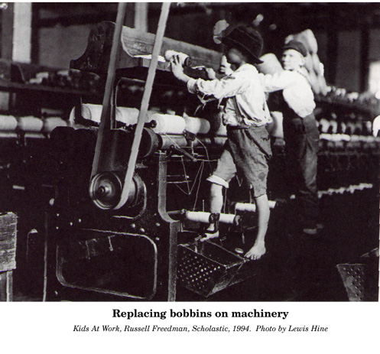
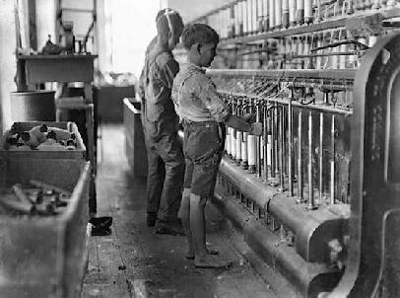

Slide 13
Labor Unions Emerge
Early Labor Organizing
National Labor Union—first large-scale national organization
1868, NLU gets Congress to give 8-hour day to civil servants
Local chapters reject blacks; Colored National Labor Union forms
NLU focus on linking existing local unions
Noble Order of the Knights of Labor open to women, blacks, unskilled
Knights support 8-hour day, equal pay, arbitration

Slide 14
Union Movements Diverge
Craft Unionism
Craft unions include skilled workers from one or more trades
Samuel Gompers helps found American Federation of Labor (AFL)
AFL uses collective bargaining for better wages, hours, conditions
AFL strikes successfully, wins higher pay, shorter workweek
Industrial Unionism
Industrial unions include skilled, unskilled workers in an industry
Eugene V. Debs forms American Railway Union; uses strikes

Slide 15
Union Movements Diverge
Socialism and the IWW
Some labor activists turn to socialism:
Government control of business, property
Equal distribution of wealth
Industrial Workers of the World (IWW), or Wobblies, forms 1905
Organized by radical unionists, socialists; include African Americans
Industrial unions give unskilled workers dignity, solidarity

Slide 16
Strikes Turn Violent
The Great Strike of 1877
Baltimore & Ohio Railroad strike spreads to other lines
Governors say impeding interstate commerce; federal troops intervene
The Haymarket Affair
3,000 gather at Chicago’s Haymarket Square, protest police brutality
Violence ensues; 8 charged with inciting riot, convicted
Public opinion turns against labor movement

Slide 17
Strikes Turn Violent
The Homestead Strike
1892, Carnegie Steel workers strike over pay cuts
Win battle against Pinkertons; National Guard reopens plant
Steelworkers do not remobilize for 45 years
The Pullman Company Strike
Pullman lays off 3,000, cuts wages but not rents; workers strike
Pullman refuses arbitration; violence ensues; federal troops sent
Debs jailed, most workers fired, many blacklisted

Slide 18
Strikes Turn Violent
Women Organize
Women barred from many unions; unite behind powerful leaders
Mary Harris Jones— most prominent organizer in women’s labor
Works for United Mine Workers
Leads children’s march
Pauline Newman—organizer for International Ladies’ Garment Workers
1911 Triangle Shirtwaist factory fire results in public outrage

Slide 19
Strikes Turn Violent
Management and Government Pressure Unions
Employers forbid unions; turn Sherman Antitrust Act against labor
Legal limitations cripple unions, but membership rises

