Slide 1
New World Beginnings
European Exploration of the New World

Slide 2
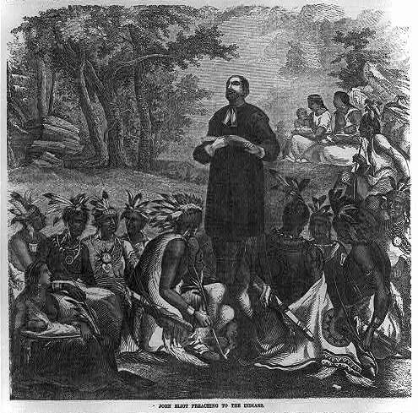
Motives for Exploration
Economic Motives
Trade route to the Indies
Gold & other riches
Land for expansion
Religious Motives
Escape persecution
Spread Christianity

Slide 3
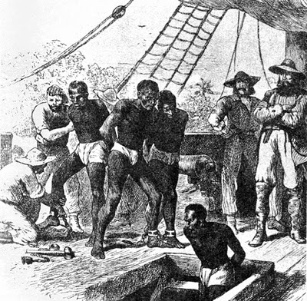
Motives for Exploration
Curiosity / Adventure
Forced Migration
African Slave Trade

Slide 4
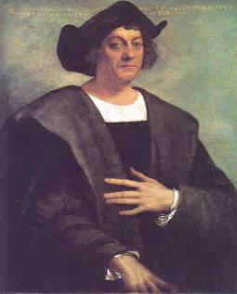
Spanish Exploration
Christopher Columbus
Goal: Find a shorter route to the East
Sailed from Spain in 1492
Not the first European to cross the ocean
His voyages led to permanent settlements

Slide 5
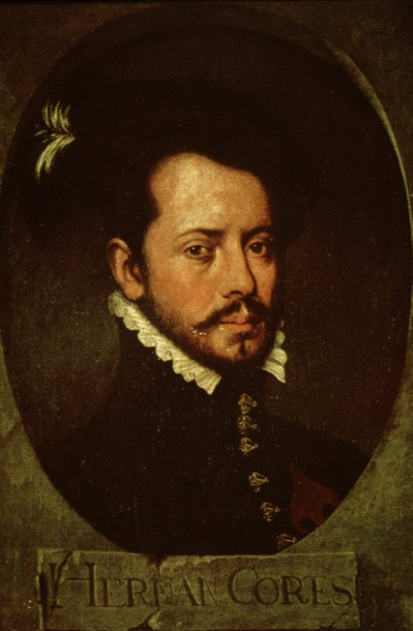
Spanish Exploration
Hernando Cortez
Goal: Find wealth in Mexico
Landed in 1519 with about 600 soldiers
Conquered the Aztecs in 1521

Slide 6
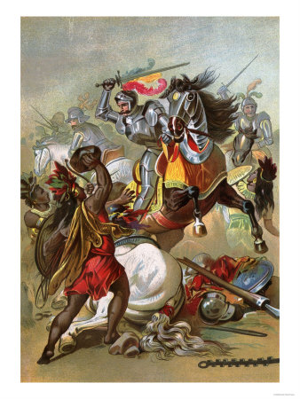
Spanish Exploration
Aztecs vs. Spanish
Aztecs believed Cortez was the god
Smallpox decimated the native population
Differing views of warfare
Spanish technology

Slide 7
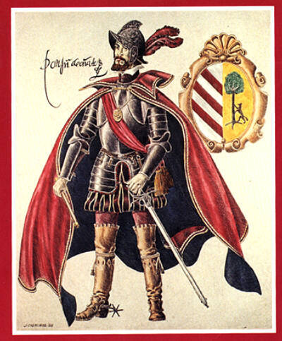
Spanish Exploration
Juan de Oñate
Led conquistadors in New Mexico in 1598
Crushed the native population at the village of Acoma
About 800 people were killed
Women & children were sold into slavery

Slide 8
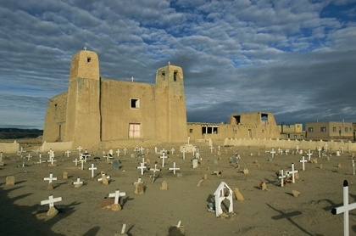
Spanish Exploration
San Esteban Rey – Acoma, New Mexico

Slide 9
Spanish Exploration
Pueblo Revolt (1680)
Led by Popé in response to Spanish attacks on traditional Pueblo practices & forced Christianity
United Native Americans in New Mexico
Drove Spain out of the area for about 10 years
One of the most successful native uprisings in US history

Slide 10
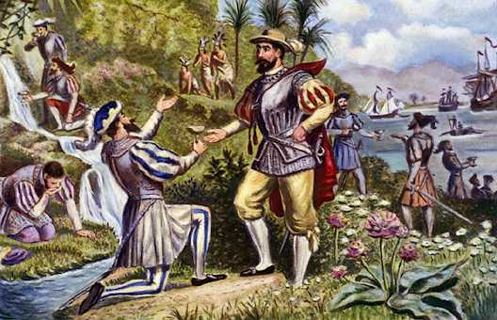
Columbian Exchange
Items exchanged between Europeans & Native Americans

Slide 11
Columbian Exchange – Crops
Native American Plants Taken to Europe
Beans
Tomato
Old World Plants Brought to America
Apple
Cabbage
Maize
Pumpkin
Squash
Potato
Tobacco
Olive
Plum
Lemon
Grapefruit
Sugarcane

Slide 13
Columbian Exchange – Horses
Prior to having horses, mobility & private property was limited
Horses, brought by the Spanish, spread to the Great Plains by the mid-1700s
Made hunting buffalo easier & more efficient
Buffalo became central to Native American’s economic & spiritual life

Slide 14
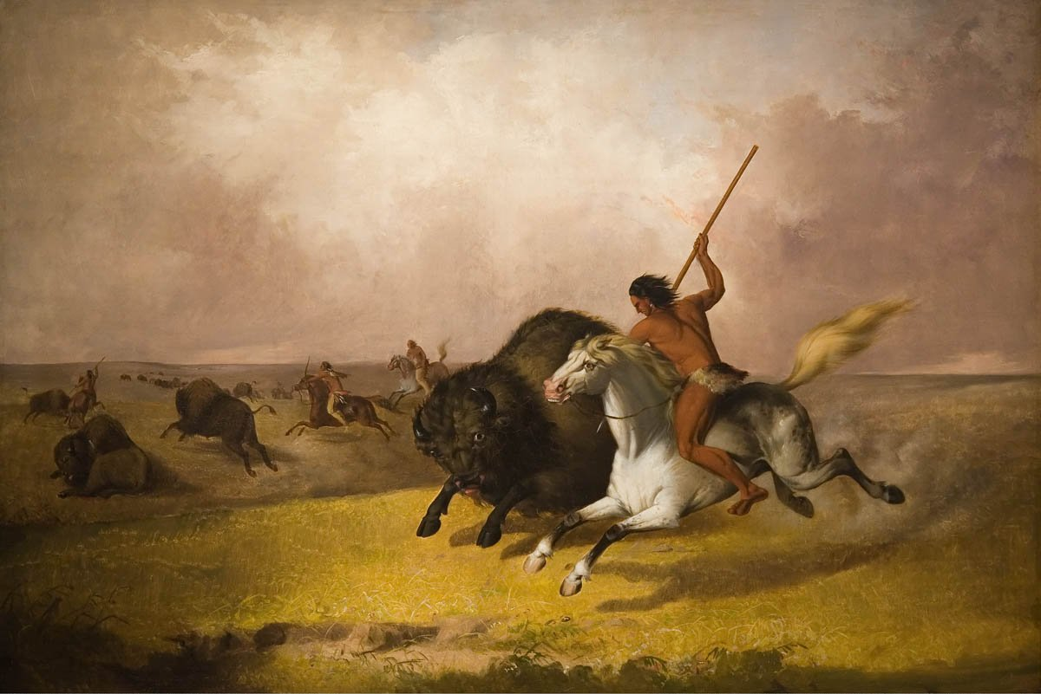
Columbian Exchange – Horses
“Buffalo Hunt on the Southwestern Prairies” by John Mix Stanley, 1845

Slide 15
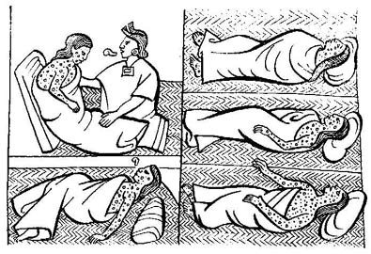
Columbian Exchange – Disease
Diseases brought by Europeans caused more deaths & destroyed more of Indian society than any other single factor
Death rates could be as high as 90-95% in some populations

Slide 16
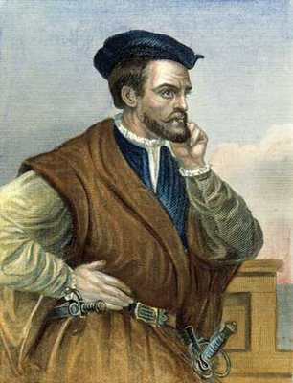
French Exploration
Jacques Cartier
Explored the east coast of Canada in the 1530s
Sailed up the St. Lawrence River to what is now Montreal

Slide 17
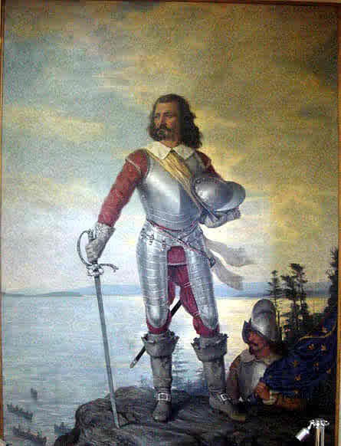
French Exploration
Samuel de Champlain
Established Quebec in 1608
Became a key trading post in the French fur trade
Helped establish an alliance with the Huron Indians
Considered to be the “father” of New France

Slide 18
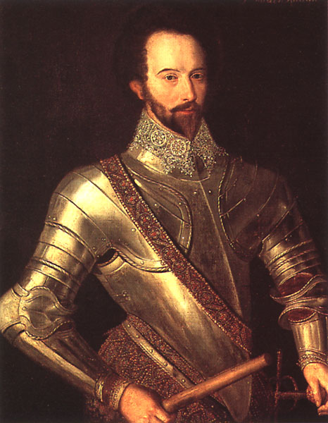
English Exploration
Sir Walter Raleigh
Instrumental in the establishment of the Roanoke colony in the 1580s
First settled in 1585 as a base for pirate ships
Poor relations with the native population
Found abandoned in 1590

Slide 19
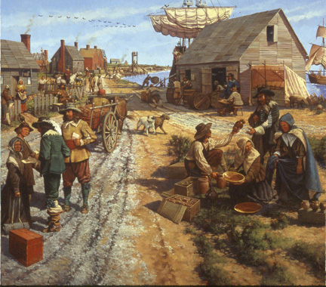
English Exploration
Jamestown
Settled in 1607
First “successful” English colony
Organized by the Virginia Company of London

Slide 20
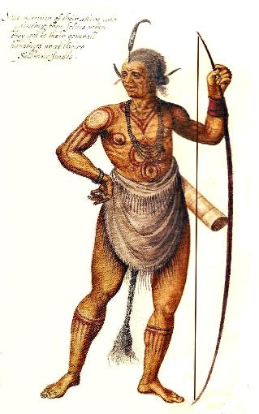
English Exploration
Jamestown – Troubles
Many settlers fell ill from disease
“Gentlemen” refused to do work
Not prepared to survive on their own
Relied on the local Powhatan Indians for food

Slide 21
English Exploration
Jamestown – John Smith
Captured by Chief Powhatan & may have been saved by his daughter, Pocahontas
Negotiated with the Powhatans to obtain access to more food
Implemented a “no work, no food” policy in the colony
Returned to England in 1609

Slide 22
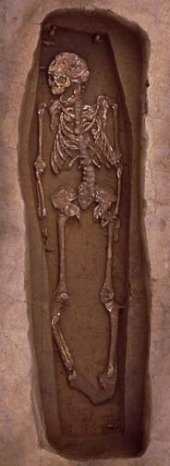
English Exploration
Jamestown – Troubles
May 1607 – 101 settlers
January 1608 – 38 survived
Jamestown – John Smith
December 1608 – 200 settlers
Spring 1609 – 188 survived
December 1609 – 500 settlers
May 1610 – 100 survived

Slide 23
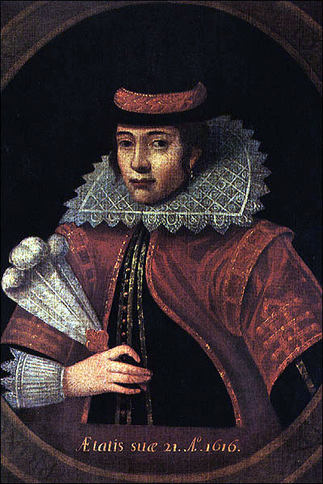
English Exploration
Economic Boom
Tobacco saved the colony from financial disaster
John Rolfe developed a new strain of tobacco that flourished in Virginia
Rolfe married Pocahontas
Eased tensions between the colonists & the Powhatans

Slide 24
English Exploration
Anglo-Powhatan War (1622-1632)
Relations between the colonists & the Powhatans worsened
In 1622 Natives struck back
Killed about 25% of Jamestown’s settlers
Colonists responded by setting out to destroy the Powhatans
Population devastated
40,000 - 500

